Slide 1


Green Pace
Security Policy Presentation
Developer: Jillian Ortiz
CS405 Secure Coding

Slide 2

OVERVIEW: DEFENSE IN DEPTH
Defense in depth is an essential security strategy that employs a well-structured layering of security mechanisms. This approach significantly enhances protection against risks and effectively mitigates potential system vulnerabilities.
Security Principles
C/C++ coding standards
Encryption
3 A’s
Authorization
Authentication
Accounting

Slide 3
THREATS MATRIX
Security risks have been populated in a threats matrix, to show examples of code that have resulted in known security vulnerabilities.
Likely STD-002-CPP STD-003-CPP STD-005-CPP STD-008-CPP | Priority STD-003-CPP (P18) STD-005-CPP (P18) STD-002-CPP (P9) STD-008-CPP (P9) STD-009-CPP (P6) STD-010-CPP (P6)
Low priority STD-007-CPP STD-001-CPP STD-004-CPP STD-006-CPP | Unlikely STD-001-CPP STD-004-CPP STD-006-CPP STD-009-CPP

Slide 4
10 PRINCIPLES
Validate Input Data | STD-004-CPP
Heed Compiler Warnings | STD-002-CPP, STD-003-CPP, STD-005-CPP, STD-006-CPP, STD-008-CPP
Architect and Design for Security Policies | STD-001-CPP, STD-009-CPP, STD-010-CPP
Keep It Simple | STD-001-CPP, STD-008-CPP, STD-009-CPP, STD-010-CPP
Default Deny | STD-005-CPP
Adhere to the Principle of Least Privilege | STD-005-CPP,
Sanitize Data Sent to Other Systems | STD-004-CPP
Practice Defense in Depth | STD-004-CPP, STD-008-CPP
Use Effective Quality Assurance Techniques | STD-005-CPP, STD-007-CPP, STD-008-CPP
Adopt a Secure Coding Standard | STD-001-CPP, STD-004-CPP, STD-006-CPP, STD-007-CPP, STD-008-CPP, STD-009-CPP, STD-010-CPP

Slide 5
CODING STANDARDS
Rule | Priority
STD-003-CPP: Do not attempt to create a std::string from a null pointer | High(P18)
STD-005-CPP: Do not access freed memory | High(P18)
STD-002-CPP: Do not attempt to modify string literals | Medium(P9)
STD-008-CPP: Handle all exceptions thrown before main() begins executing | Medium(P9)
STD-009-CPP: Do not modify the standard namespaces | Medium(P6)
STD-010-CPP: Use valid iterator ranges | Medium(P6)
STD-007-CPP: Do not abruptly terminate the program | Low(P4)
STD-001-CPP: Obey the one-definition rule | Low(P3)
STD-004-CPP: Avoid information leakage when passing a class object across a trust boundary | Low(P1)
STD-006-CPP: Use a static assertion to test the value of a constant expression | Low(P1)

Slide 6
ENCRYPTION POLICIES
Encryption at rest | Encryption at rest protects stored data, including hard drives, phones, computers, and cloud assets. Data protection is achieved through encryption tools, disk encryption, and security for mobile devices and computers.
Encryption in flight | Encryption in flight is the process of securing data while it is moving. This can occur between two devices within a network or while the data is transferring outside of a network. Examples of protecting data in transit include email encryption, DLP (Data Loss Prevention) solutions, and robust network security features like firewalls and authentication. It is crucial to also consider the specific path that the data may take and ensure the security of this pathway.
Encryption in use | Encryption in use protects data that is being created, edited, or otherwise in use. To ensure data security, it is important to have control and protection measures in place before the data is accessed. Managing access rights and user identity can also help minimize the risk to this data.

Slide 7
TRIPLE-A POLICIES
Authentication | Authentication is the definitive process of confirming an individual's identity. This encompasses various forms, including static passwords, one-time passwords, certifications, and biometric credentials. These forms of identification unequivocally verify that a person is who they claim to be.
Authorization | Authorization specifies the access rights and privileges of a user and is an important part of information and computer security. While authentication confirms an identity, authorization determines what a user can and cannot access, limiting potential vulnerabilities when someone interacts with sensitive data they don't need to access or has permissions during access.
Accounting | Accounting involves keeping track of activities when interacting with a system. It includes showing timestamps, accessed resources, and data transfer information. This is important for creating a trail of user activity and for forensic analysis and investigation if needed.

Slide 8
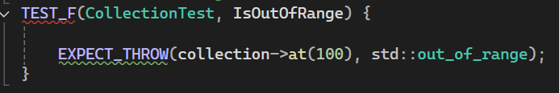
IsOutOfRange
Memory Protection: Verify the std::out_of_range exception is thrown when calling at() with an index out of bounds

Slide 9
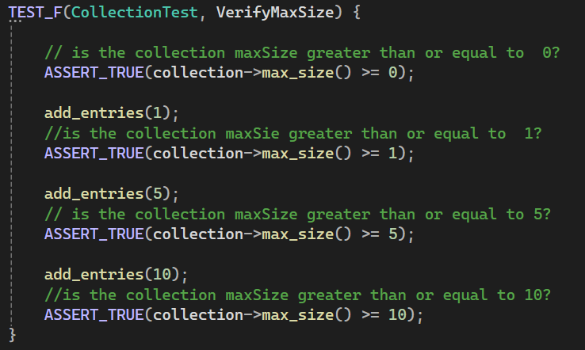
VerifyMaxSize
Memory Protection: Verify that the max size is greater than or equal to the size for x amount of entries.

Slide 10
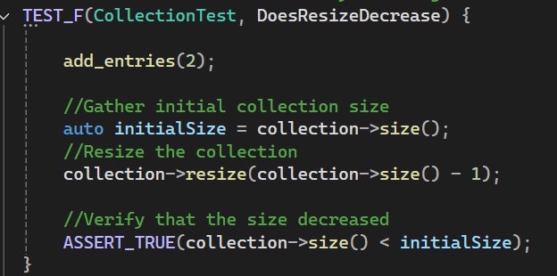
DoesResizeDecrease
Memory Protection: Verify resizing decreases the collection

Slide 11
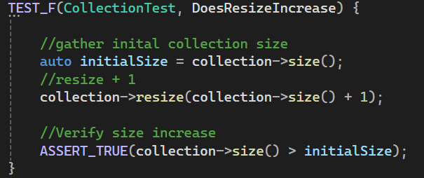
DoesResizeIncrease
Memory Protection: Verify resizing increases the collection

Slide 12

AUTOMATION SUMMARY

Slide 13
TOOLS
In traditional software development practices, organizations typically add security measures for applications and infrastructure after the testing phase. In contrast, DevSecOps integrates security into the DevOps pipeline from the very beginning. This means that security is considered and implemented simultaneously as the code is written and the application is developed.
CPPCheck is a static analysis tool used to check for runtime errors
Google Test automated unit tests based on user defined assertions

Slide 14
RISKS AND BENEFITS
When encountering a security threat we can either wait, or act immediately. This is usually decided based on key factors based on threat severity, remediation costs, and manpower or labor needed.
Immediate remedies usually mean containment by either shutting down the affected systems or subsystems, or stopping any unauthorized activity, removing all corrupted/compromised data, updating or resetting user credentials,, and continual monitoring of system entry/exit points.
Risks of delayed reaction:
Open for more attacks
Further data loss
Harming reputation
Losing customer’s trust and business
Benefits of immediate action:
Mitigating widespread damage
Preventing future threats
Maintaining consistent performance
Delivering quality customer service.

Slide 15
RECOMMENDATIONS
Encrypt Everywhere
Triple A framework
External tools to run vulnerability tests
Unit testing

Slide 16
CONCLUSIONS
Taking the extra steps from the start, implementing Defense in Depth, and incorporating security testing into everyday practice will allow DevOps to be transformed into DevSecOps here at Green Pace. Adopting all standards will improve the security of systems and applications.

Slide 17
REFERENCES
Atlassian. (n.d.). DevSecOps Tools. Atlassian. https://www.atlassian.com/devops/devops-tools/devsecops-tools‌
GeeksforGeeks. (2023, December 10). What is DevSecOps Overview and Tools. GeeksforGeeks; GeeksforGeeks. https://www.geeksforgeeks.org/what-is-devsecops/
Malviya, N. (2022, September 26). Understanding the DevSecOps Pipeline [Review of Understanding the DevSecOps Pipeline]. Infosec. https://www.infosecinstitute.com/resources/application-security/understanding-the-devsecops-pipeline/
The DevSecOps Lifecycle: How to Automate Security in Software Development | Mayhem. (2023). Mayhem.security. https://www.mayhem.security/blog/the-devsecops-lifecycle-how-to-automate-security-in-software-development
Yuga. (2024, February 15). What is DevSecOps Pipelines? - Comprehensive Guide - Practical DevSecOps. Practical DevSecOps. https://www.practical-devsecops.com/what-is-devsecops-pipelines/

